Slide 1

Project A
Gustavo Nieves
Cohort 23C

Slide 2
Summary
I have been hired to implement Virtual Machines instead of more hardware to help reduce costs and to meet the client’s operational needs. This includes installing a Firewall, a PC for the CEO, a Webserver, DNS server, and some Linux machines. A security baseline will be created and tested for reassurance.

Slide 3
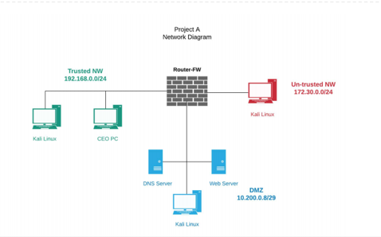
Network Diagram

Slide 4
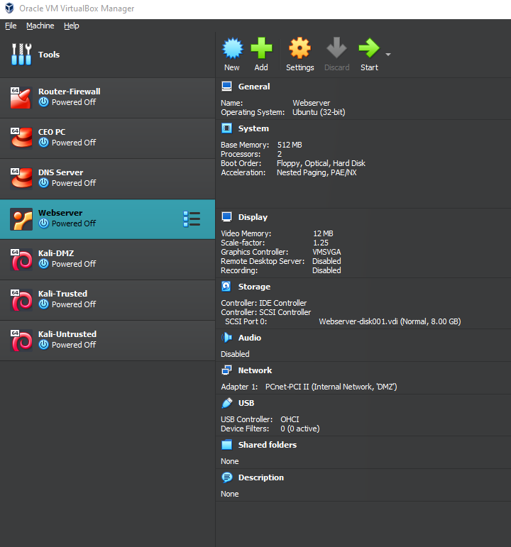
Task 1
Install the following:
Router-FW
DNS Server
Webserver
CEO PC
3 Kali Linux Computers

Slide 5
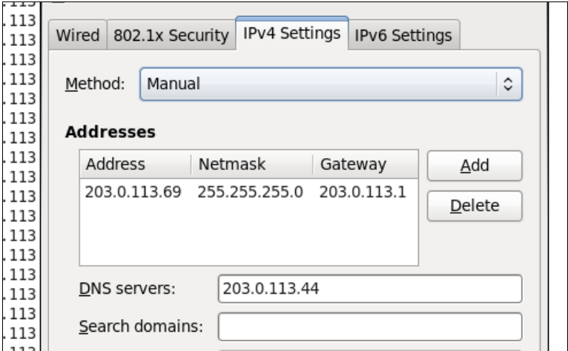
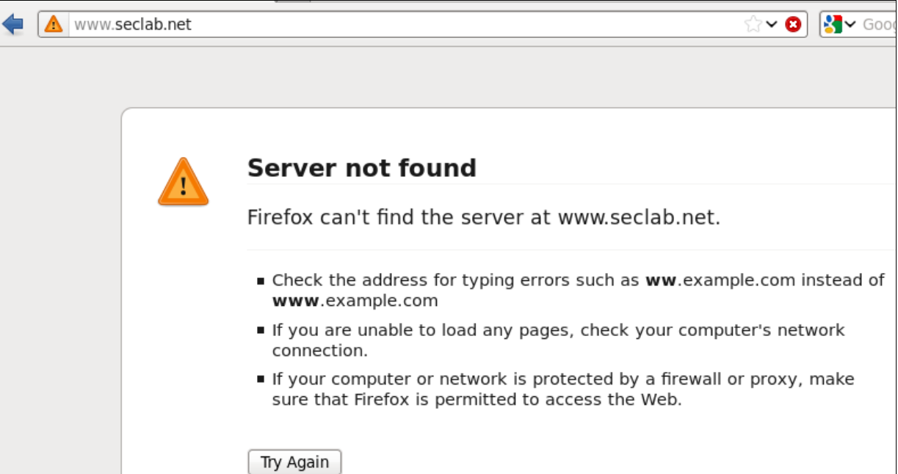
Task 2
Troubleshoot CEO PC
Old IP
Website

Slide 6
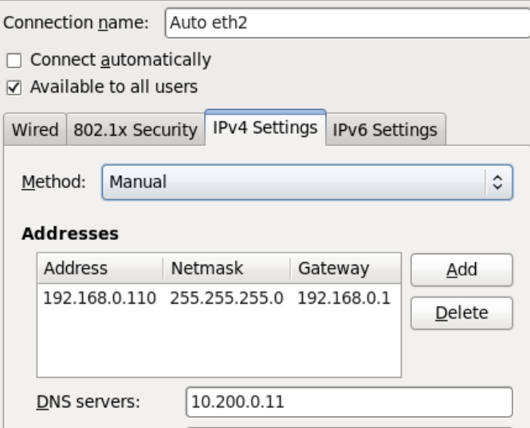
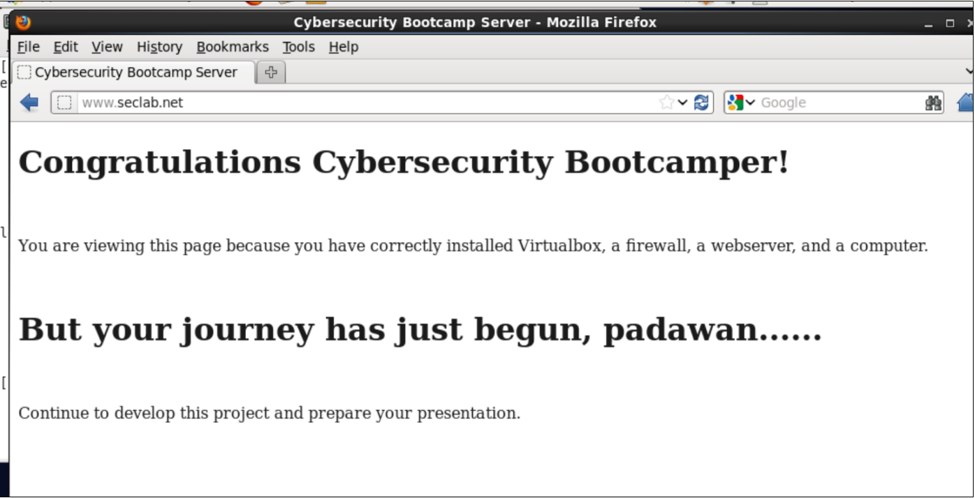
Task 2
Troubleshoot CEO PC
New IP
Website

Slide 7
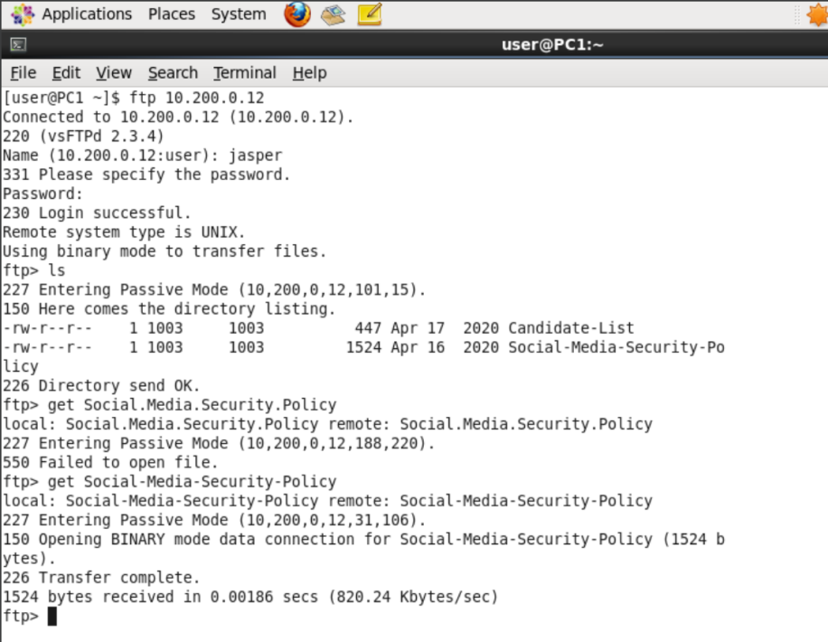
Task 3
Download Social Media Policy

Slide 8
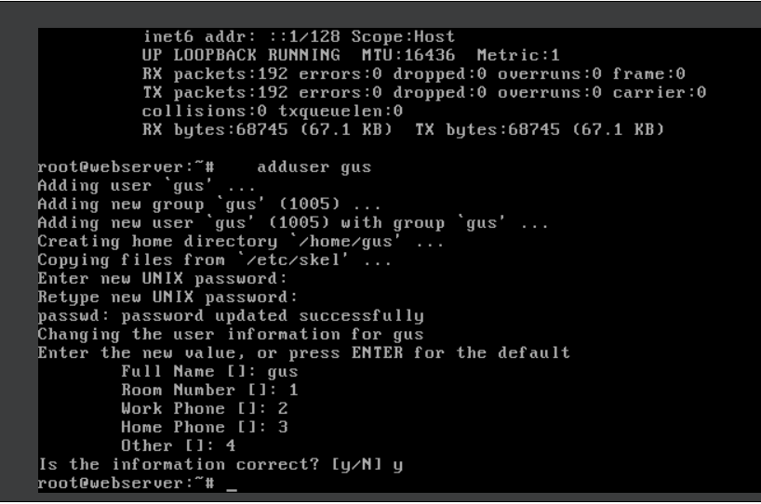
Task 4
New user on Web Server

Slide 9
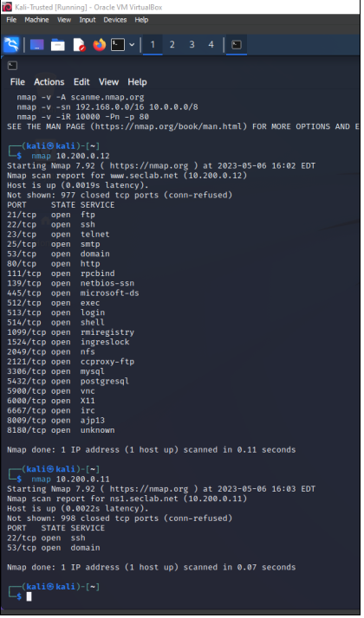
Task 5
Webserver →
Port Scans
DNS Server →

Slide 10
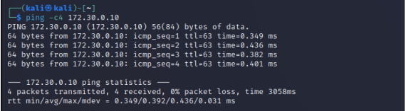
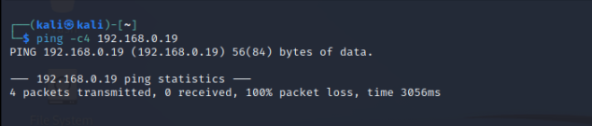
Task 6
Trusted network is protected from untrusted
Trusted to Untrusted Ping
Untrusted to Trusted Ping

Slide 11
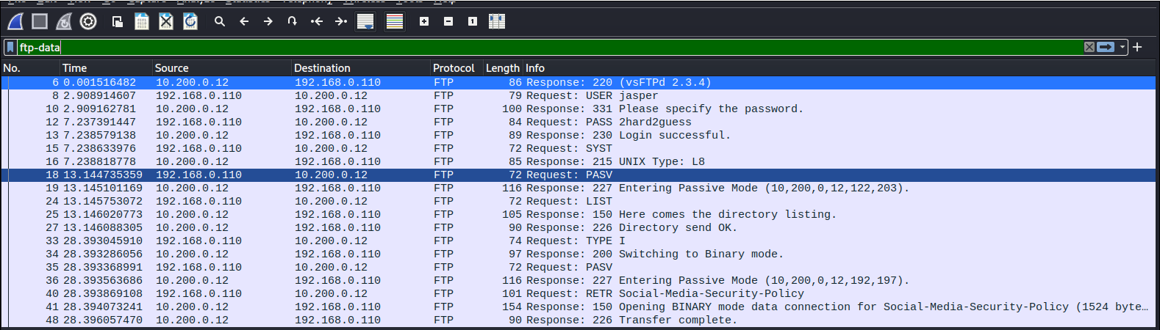
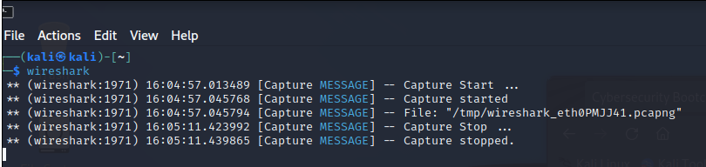
Task 7
Use Wireshark on KALI

Slide 12



Closing Remarks
Things Learned from the Project:
Installed and Troubleshoot Operation Systems
Use Network Tools
Create and Test Security Baselines

Slide 13

Questions?

